Slide 1
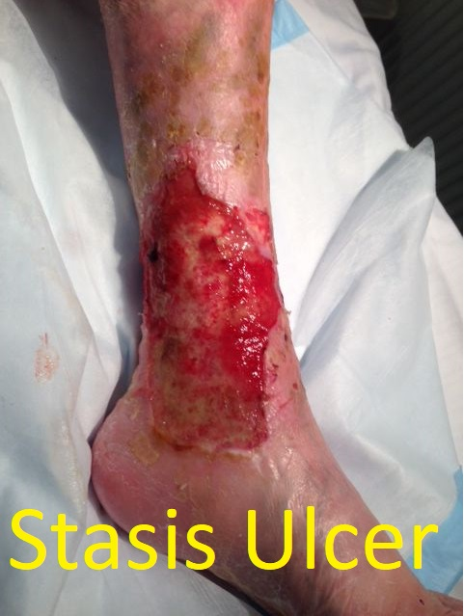
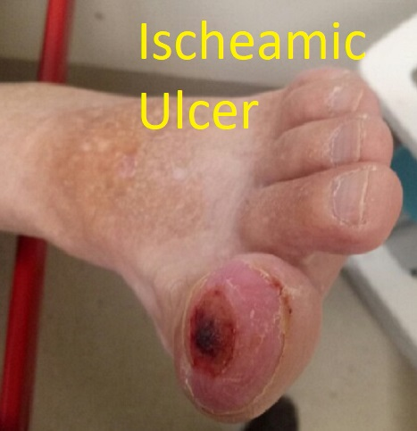
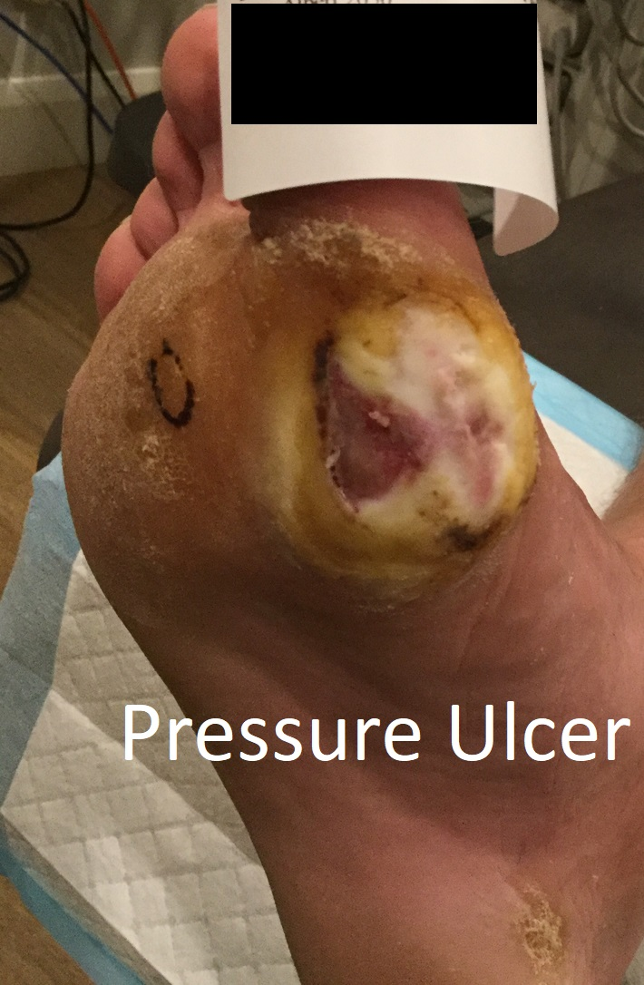
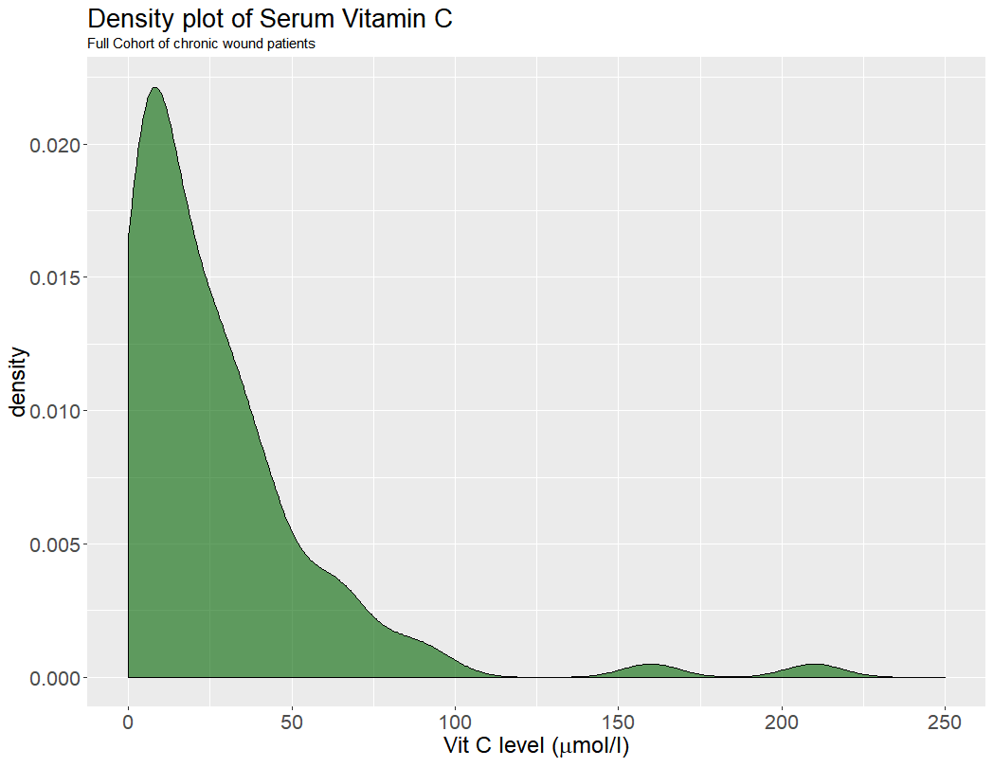
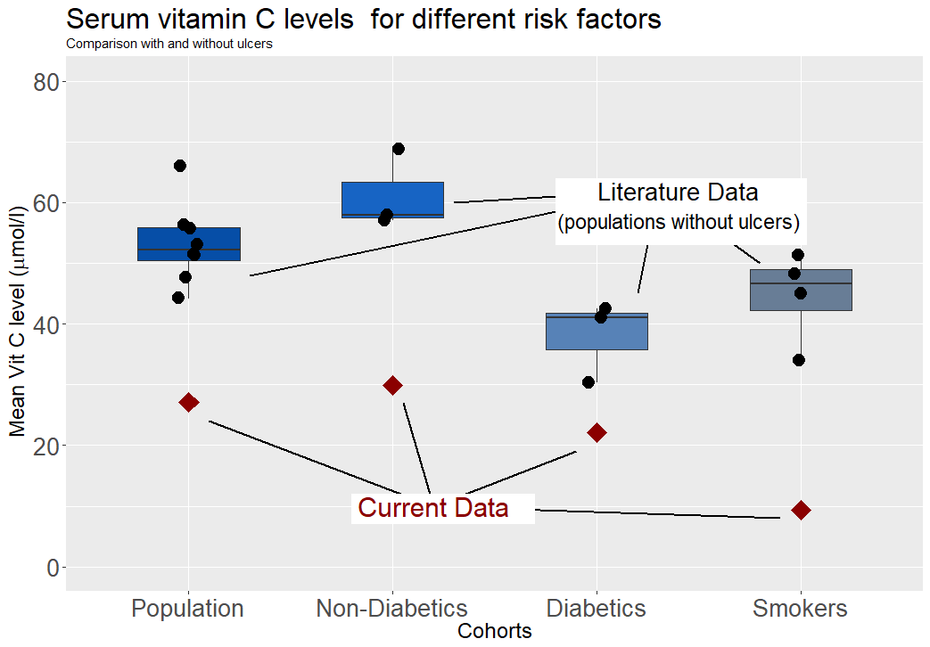
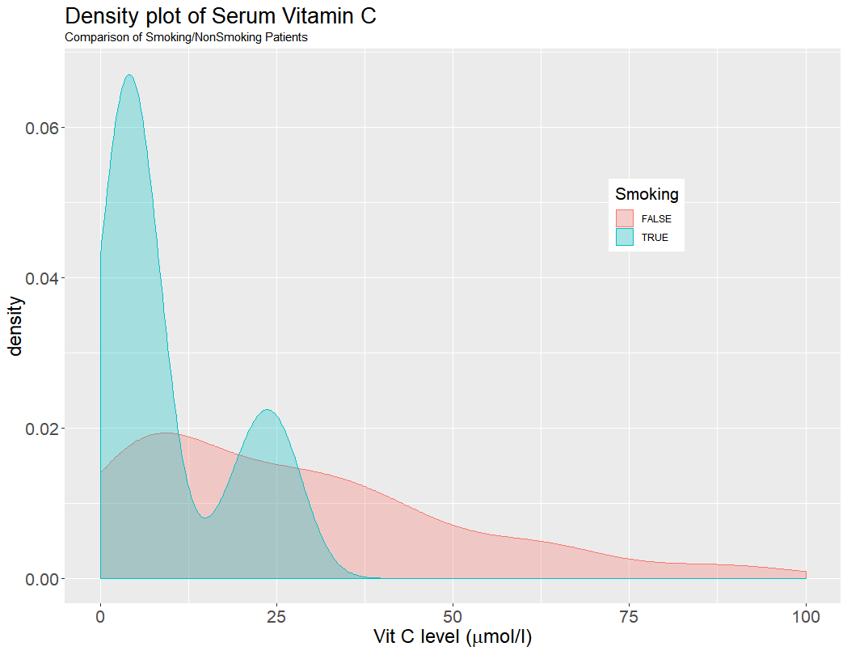
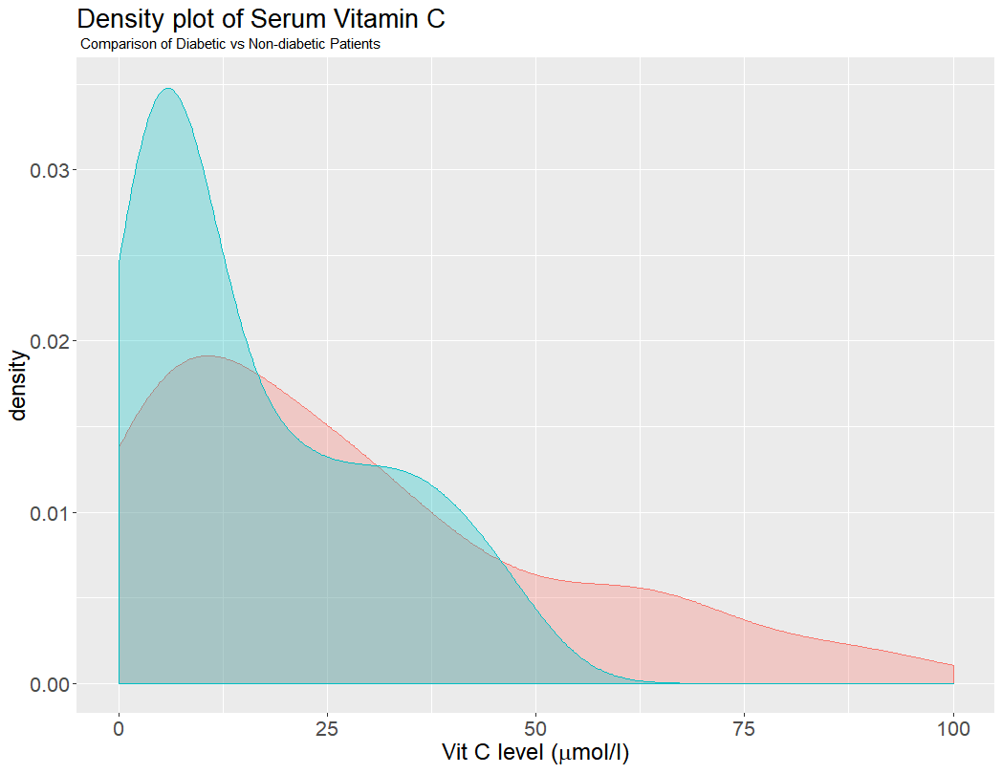

51% of diabetic patients with leg ulcers have critically low Vitamin C
Airey, DK., Riverina Endovascular, Wagga Wagga, NSW, Australia
Ndayisaba E., Lyell McEwin Hospital, Adelaide, South Australia
Background
Vitamin C is derived from glucose and retains many of the same metabolic pathways including insulin mediated transport. Humans lack the ability to synthesise vitamin C so rely of continuous dietary intake. Low levels of vitamin C are associated with poor healing of wounds and profound deficiency (< 6 µmol/L) can lead to scurvy. Although increasingly uncommon, rates of severe vitamin C deficiency are seen in the obese and lower socioeconomic demographics and average levels are lower in diabetic and in smokers. Vitamin C is acutely depleted in severe burns, sepsis and after surgery but the effect of chronic wounds is less known. Since 2016, patients attending the Riverina Endovascular Wound Clinic (Wagga Wagga, NSW, Australia) have been offered a nutritional screen. Low Vitamin C was surprisingly common and prompted an audit of these tests
Method
The electronic medical record (Genie Solutions - Fortitude Valley, QLD, Australia) of patients attending the clinic were searched for nurition screens which were collated along with demographic data, diabetic and smoking status. Ulcer locations were recorded as calf, foot or malleolus. In the case of multiple lesions or lesions involving more than one region, the most involved region was listed. The presence of inhibitors to healing were recorded: Ischemia chronic stasis, or repetitive pressure trauma. If more than one factor was deemed to be clinically significant by the treating clinician, then all factors were included.
Demographics of patients and ulcer characteristics (N=92)
Gender | Male n₁=53 |  | Female n₂= 39
Age | Mean =75 years |  | St Dev =12 years
Path Lab. | DHM n₁ = 58 |  | Laverty n₂=34
Diabetic status | Diabetic n₁= 33 |  | Non-diabetic n₂=59
Smoking status (N=78) | Active Smoker n₁=11 |  | Non-Smoker n₂= 67
Ulcer Location | Calf n₁ = 52 | Malleolus n₂ =11 |  | Foot n₃=24
Healing Inhibitor* | Stasis n₁ = 47 | Ischemia n₂ = 45 |  | Pressure n₃ = 12
* Lesions may result from more than one healing inhibitor, so category totals add to > 92.
Discussion
Vitamin C (ascorbic acid) is involved in multiple physiological pathways, most prominently as a co-enzyme in the synthesis of collagen, and as a scavenger of the free radicals . Routine surgery, sepsis and burns are associated with acute reductions in vitamin C levels, attributed to the consumption of vitamin C by the reactive oxygen species induced by inflammation. The chronicity of many lower limb ulcers represents failure to progress from the inflammatory- to the proliferative- phase of healing. A similar drain on ascorbic acid could thus be predicted but the extent of the problem is not well established
In this outpatient population, vitamin C levels were markedly lower found in literature surveys, including 40.2% at levels associated with the development of scurvy, although no patient presented with clinical manifestations of that disease, The effect was greater in groups already known to have relatively low vitamin C –smokers and diabetics- again with average levels lower than similar cohorts in the literature. This likely represents a ‘two-hit’ mechanism.
Two weakness of this retrospective audit should be mentioned. Vitamin C metabolism and storage is complex and serum levels may not be the best marker for clinical deficiency. Second, incorrect handling of serum sample may lead to artificially low results and is not controlled for in this data.
 | Diabetic | Non-Diabetic
Mean Vit C | 22.1 µmol/L | 29.9µmol/L
Depletion | 51% | 34%
 | Smoker | Non-Smoker
Mean Vit C | 9.4µmol/L | 31.8 µmol/L
Depletion | 73% | 34%
Vitamin C levels in this cohort are markedly skewed toward low levels. The mean for all patients was 27 µmol /L, significantly lower than seen in whole-population surveys. Severe deficiency (defined as < 6umol/L) was noted in 37/92 (40.2%) compared with 2-7% in broad population surveys.
The skew was exacerbated in diabetic and active smokers with the mean levels being 22.1µmol/L for diabetics and 9.4µmol/L in smokers, again both significantly lower than matched cohorts without ulcers. Rates of severe deficiency were 17/33 ( 51% ) for diabetics and 8/11 (73% ) active smokers
Conclusion
Data presented here suggests that chronic wounds represents a clinically significant drain on vitamin C stores. When additional risk factors such as smoking and diabetes are present, depletion commonly reaches levels historically associated with the development scurvy. To-date, the effects of supplementation on chronic wounds have not been quantified, but a positive effect on rates of healing is biologically reasonable.
Nutritional screening for patients with non-healing ulcers is justified.
Active smokers and diabetic patients with ulcers should be considered for supplementation at first presentation.
References:-
R. Wilson et al., “Inadequate Vitamin C Status in Prediabetes and Type 2 Diabetes Mellitus: Associations with Glycaemic Control, Obesity, and Smoking,” Nutrients, vol. 9, no. 9, p. 997, Sep. 2017.
A. Mosdol, B. Erens, and E. J. Brunner, “Estimated prevalence and predictors of vitamin C deficiency within UK’s low-income population,” J. Public Health, vol. 30, no. 4, pp. 456–460, Dec. 2008.
J. F. Pearson et al., “Vitamin C Status Correlates with Markers of Metabolic and Cognitive Health in 50-Year-Olds: Findings of the CHALICE Cohort Study,” Nutrients, vol. 9, no. 8, Aug. 2017.
K. Langlois, M. Cooper, and C. K. Colapinto, “Vitamin C status of Canadian adults: Findings from the 2012/2013 Canadian Health Measures Survey,” Health Rep., vol. 27, no. 5, pp. 3–10, May 2016.
R. L. Schleicher, M. D. Carroll, E. S. Ford, and D. A. Lacher, “Serum vitamin C and the prevalence of vitamin C deficiency in the United States: 2003-2004 National Health and Nutrition Examination Survey (NHANES),” Am. J. Clin. Nutr., vol. 90, no. 5, pp. 1252–1263, Nov. 2009.
W. Wrieden, M. Hannah, C. Bolton-Smith, R. Tavendale, C. Morrison, and H. Tunstall-Pedoe, “Plasma vitamin C and food choice in the third Glasgow MONICA population survey,” J. Epidemiol. Community Health, vol. 54, no. 5, pp. 355–360, May 2000.
K. Nyyssönen, M. T. Parviainen, R. Salonen, J. Tuomilehto, and J. T. Salonen, “Vitamin C deficiency and risk of myocardial infarction: prospective population study of men from eastern Finland.,” BMJ, vol. 314, no. 7081, pp. 634–638, Mar. 1997.
J. Pincemail et al., “Lifestyle Behaviours and Plasma Vitamin C and β-Carotene Levels from the ELAN Population (Liège, Belgium),” J. Nutr. Metab., vol. 2011, 2011.B. Bates et al., Eds., “National Diet and Nutrition Survey Results from Years 1, 2, 3 and 4 (combined) of the Rolling Programme (2008/2009 – 2011/2012).” Public Health England, May-2014.
P. Galan et al., “Serum concentrations of beta-carotene, vitamins C and E, zinc and selenium are influenced by sex, age, diet, smoking status, alcohol consumption and corpulence in a general French adult population,” Eur. J. Clin. Nutr., vol. 59, no. 10, pp. 1181–1190, Oct. 2005.
L. Malmauret, Jc. Leblanc, I. Cuvelier, and P. Verger, “Dietary intakes and vitamin status of a sample of homeless people in Paris,” Eur. J. Clin. Nutr., vol. 56, no. 4, pp. 313–320, Apr. 2002.
R. Fukushima and E. Yamazaki, “Vitamin C requirement in surgical patients,” Curr. Opin. Clin. Nutr. Metab. Care, vol. 13, no. 6, pp. 669–676, Nov. 2010.

